Slide 1
Introduction to Integers

Slide 2
TABLE OF CONTENTS
Basic Introduction
Integer Interactions and Multiples
Divisibility and Divisors
Summary + Practice Problems

Slide 3
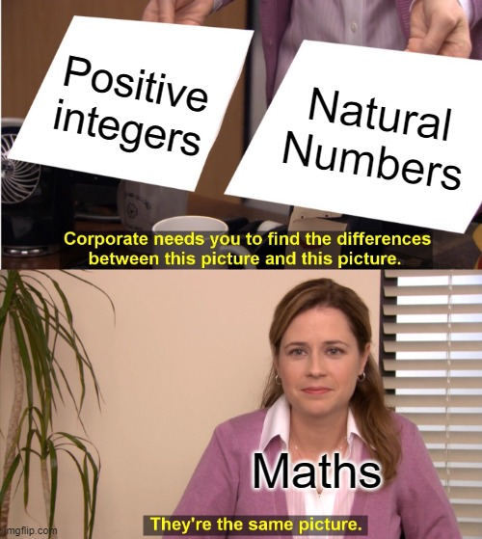
1. Basic Introduction
Integers are numbers without decimals, like -4, 0, 5, and 1048383.
There are three main groups of integers
Negative integers (integers that are less than 0, like -5, -3, and -1)
Zero (just 0)
Positive Integers (integers that are greater than 0, like 1, 5, and 72)
Some other names are
Natural Numbers: positive integers (1, 2, 3…)
Counting Numbers: same as natural numbers
Whole Numbers: positive integers and zero
There is a lot of repetition between these different terms, and you’ll get plenty of practice using them later!

Slide 4
2. Integer Interactions and Multiples
Perfect Powers
A perfect power is an integer raised to the power of an integer that greater is than or equal to two.
Perfect squares, like 3² and 4², are when the power is 2.
Perfect cubes have a power of 3.
Multiples
A multiple of an integer is the product of that and any other integer.
Eg: 20 is a multiple of 4 as it is 4 x 5.
However, 21 is not a multiple of 4 since 4 can’t be multiplied with another integer to give 21.
Basic Integer Operations.
Adding two integers results in an integer.
Eg: 4 + 5 = 9 and -2 + 4 = 0
Subtracting two integers results in an integer.
Eg: 4 - 5 = -1 and -6 - 2 = -8
Multiplying two integers results in an integer.
Eg: 4 x 5 = 20, (-1) x 5 = -5
Division is an EXCEPTION.
Consider ⅔ or ¾ - these are integers divided by integers, but are obviously not integers themselves.

Slide 5
PRACTICE: Integer Multiples
Is 27 a multiple of 9?
Is 1001 a multiple of 13?
Is 25 a multiple of 4?
Is 0 a multiple of 3?

Slide 6
3. Divisibility and Divisors
PRACTICE
Is 15 a divisor of 3?
Is 15 divisible by 5?
Does 11 divide 99?
Which is a proper divisor of 85?
3
5
7
85
If a/b is an integer, a is divisible by b.
Eg: 40/8 = 5, and 5 is an integer, so 40 is divisible by 8.
Because 40 is divisible by 8, we call 8 a divisor or factor of 40.
We can also say that 8 divides 40.
In general, if a is divisible by b, b divides a and is a factor/divisor of a.
A proper divisor of an integer n is a positive divisor of n apart from itself.

Slide 7
3. Divisibility and Divisors
Some important results and notes:
Because 0/n = 0, n, any integer except 0, is a divisor of 0.
When finding the positive divisors of a positive integer n (the same can be done for a negative n as well in a similar fashion), check numbers between 0 and n.
PRACTICE
Find the positive divisors of 15.
Find the proper divisors of 24.
Find all the divisors of 6.
This concept is the same as multiples, but from a different perspective.
If a/b is an integer c, b x c = a, so a is a multiple of b.
This only is true if b ≠ 0, as that would cause a division by zero error.
Hence, if m is divisible by n, m is a multiple of n AS LONG AS n does not equal 0.
REMEMBER: Negative integers can also be divisors or multiples, it’s not just positive integers.

Slide 8
3. Divisibility and Divisors
NOTATION
If a is a divisor of b, we say a | b.
If a is NOT a divisor of b, a ∤ b.
PRACTICE
5 | 25?
168 | 4?
If 124 divides x, is 4 a divisor of x?
Given that 143 divides 1001, is 23023 divisible by 11?
Here is one basic concepts to understand.
If a is a divisor of b and b is a divisor of c, then a is a divisor of c.
A simple proof is as follows;
This is the exact same as saying
If b is divisible by a and c is divisible by b, then c is divisible by a.
or
If b is a multiple of a and c is a multiple of b, then c is a multiple of a.

Slide 9
4. Summary
Integers are either positive, negative, or zero.
Integers can be classified as natural (counting) numbers or whole numbers.
A perfect power is an integer raised to a power c where c is greater than or equal to 2.
Perfect squares and cubes are examples of this.
A multiple of an integer is the product of that integer with any integer.
Because of this definition, 0 is a multiple of every integer.
If m/n is an integer, m is divisible by n.
This means n is a divisor or factor of m.
A proper divisor of a number n is every divisor of n except itself.
n divides m.

